Slide 1
Lyte (5B Aluminuim) Ladder- Gravity Safety Catch 21/11/2022 Issue 1.0
To: All Openreach Partners and third party contractors
Our Partners have reported an issue with the gravity safety catch pins on the 5B Lyte ladders.
What’s the issue?
Our ladder 5B Aluminium ladders are fitted with a gravity safety catch on the top section, it locks this section in place whilst the middle section is being extended or lowered. On defective ladders, the pins retaining the gravity safety catch are dropping out. (our partner is supporting the manufacturer in establishing root cause with mechanical wear against the middle section of the ladder being investigated.)
If both pins are missing:
Under certain circumstances the top section could come off unexpectedly whilst the ladder is being extended or lowered.
Users can mistake the unstable/mom-load bearing gravity safety hatch for a ladder rung
The gravity safety catch swings freely and can strike against user.
There is additional evidence that the current pin design is also leading to mechanical wear to the stile of the middle section of the ladder- this is also being closely monitored.
Action
Please always remember to complete your pre-use checks and if you identify any issues, please raise this as a product alert and report to your Line Manager and your Health and Safety
Contact point: SafetyPartners@Openreach.co.uk Issued by the Openreach Contractor Safety Team

Slide 2
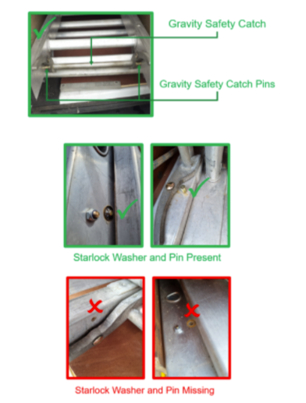
Lyte (5B Aluminuim) Ladder- Gravity Safety Catch 21/11/2022 Issue 1.0
To: All Openreach Partners and third party contractors
Contact point: SafetyPartners@Openreach.co.uk Issued by the Openreach Contractor Safety Team

